Slide 1

TED Talk Recommender
Project 5
September 16, 2019
Ferdinand Wohlenberg
Notes:
Good morning everyone, my name is Ferdinand and for my passion project, i chose to build a TED Talk Recommendation System.

Slide 2

Why?
Motivation:
TED Recommends only allows user to choose from a specific set of keywords/areas
Exploring trends through topics of videos
Goal:
Creating a sophisticated TED Talk Search Engine
Notes:
Why did I choose this project?
Well TED Recommends which is a subpage of the ted.com website only allows users to choose from a specific set of keywords or areas to specify the preferences of the user.
But you can‘t search for discreet topics or get videos recommended according to a whole text
In addition, I wanted to analyze trends over time by looking at the topics of TED Talks
Therefore, goal of the project: Create a sophisticated TED Talk Search Engine

Slide 3
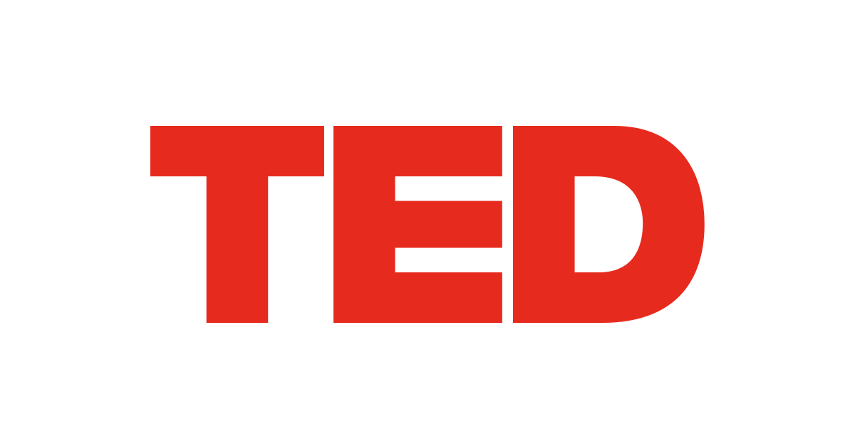


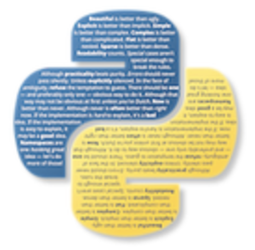
How? - Methodology
Data Preprocessing
Source:
Operations:
Scraped >4,000 Ted Talks
Filtered for English videos
Cleaned up transcripts and descriptions
Notes:
How did I approach this project?
I started with Data Preprocessing by scraping over 4,000 TED Talks from the offical Ted.com website
-I then Filtered for english videos
Cleaned up transcripts and description
As tools in this stage I used Selenium, BeautifulSoup and NLTK

Slide 4

How? - Methodology
Data Preprocessing
Modelling
Source:
Operations:
Scraped >4,000 Ted Talks
Filtered for English videos
Cleaned up transcripts and descriptions
Unsupervised ML (NLP)
Topic Modelling (NMF)
Vectorization (TF-IDF)
> 200 stopwords
32 Topics
Recommender System
TF-IDF -> NMF
Input auto-detection
Notes:
The second part consisted of the Modelling process where I mainly engaged in Unsupervised Machine Learning
Initially, I conducted Topic Modelling using a TF-IDF Vectorizer with over 200 stopwords and then using NMF to assign the TED talks to distinct 32 topics
The second part of the modelling consisted of developing a recommender system:
Again, I used TF-IDF Vectorizer and NMF to construct a recommender, that even auto detects input whether it‘s a text, keywords or link
As tools, I used the scikitlearn library

Slide 5

How? - Methodology
Data Preprocessing
Modelling
Results
Source:
Operations:
Scraped >4,000 Ted Talks
Filtered for English videos
Cleaned up transcripts and descriptions
Unsupervised ML (NLP)
Topic Modelling (NMF)
Vectorization (TF-IDF)
> 200 stopwords
32 Topics
Recommender System
TF-IDF -> NMF
Input auto-detection
Input:
Link
Keywords
Text
Output:
Ted Talk Recommendations
Notes:
The end product is a recommender system running on a flask web app
- Link, Keywords and Text are valid inputs and TED Talks as output

Slide 6
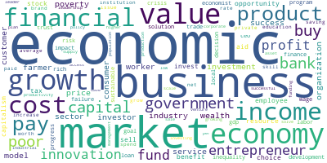
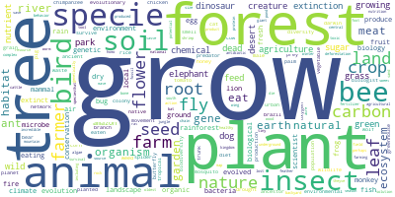
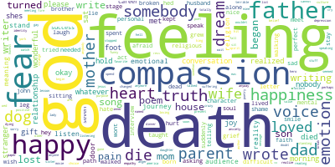
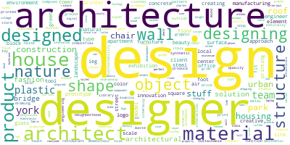
EDA Insights – Most Common Topics
Economy
Ecosystem
Religion
Architecture/Design
Notes:
Here are the most common topics displayed using wordclouds.
- Economy is most common topic closely follwed by ecosystem
- Surprisingly, Religion and Architecture/design are also very popular topics

Slide 7
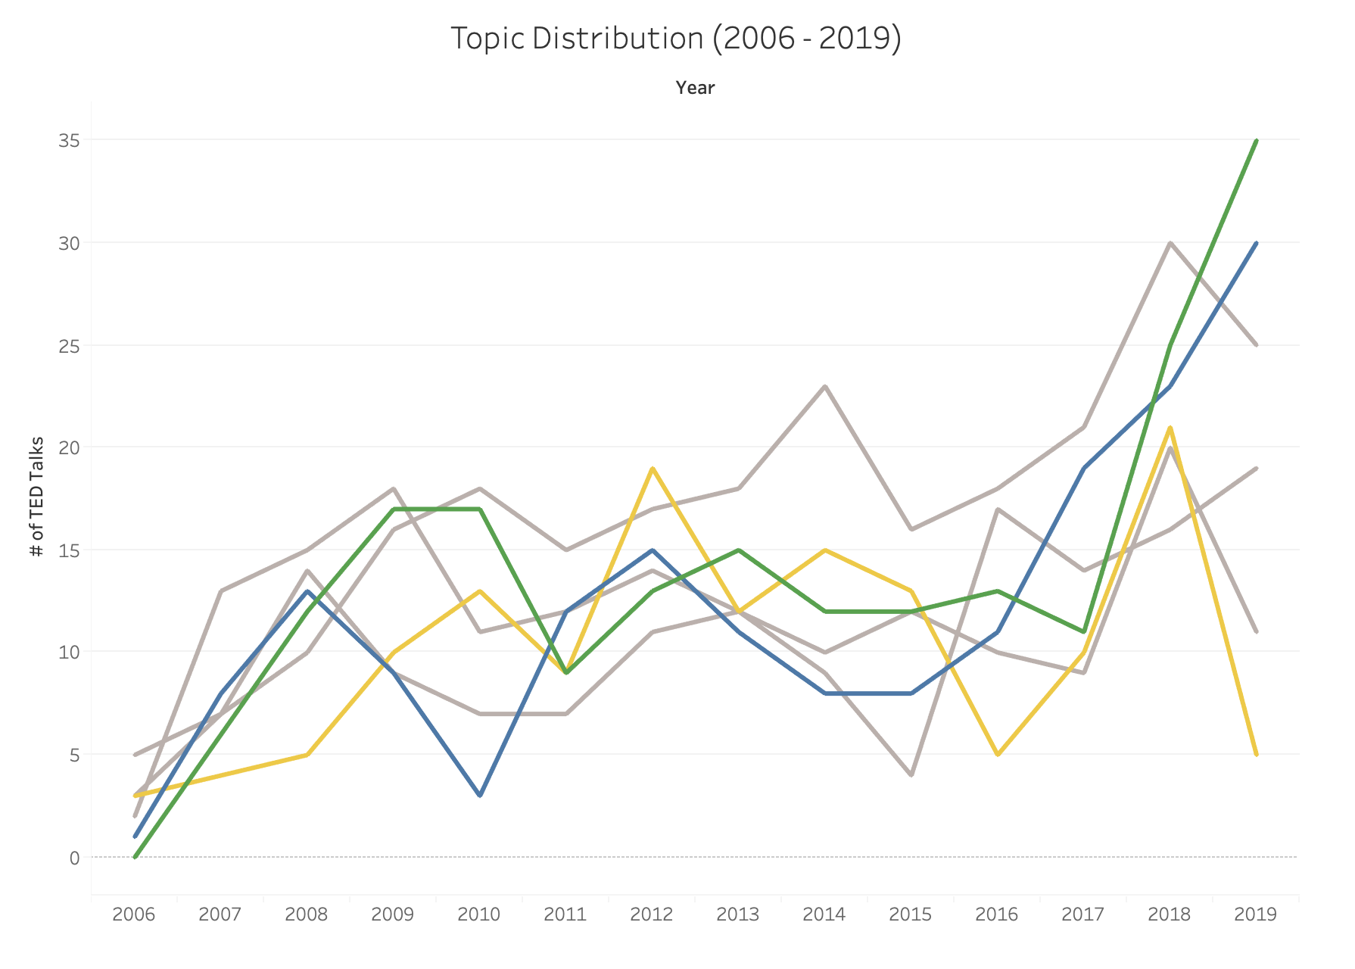
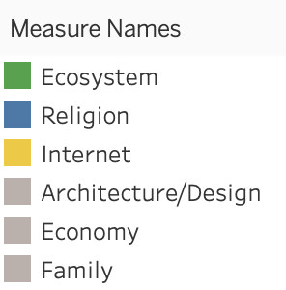
EDA Insights- Topic Distribution Over Time
Notes:
This is a visual representation of the 6 most common topics and how they developed over time.
- A clear trend towards sustainability and religion can be identified, while Internet for example lost in relevance in 2019

Slide 8
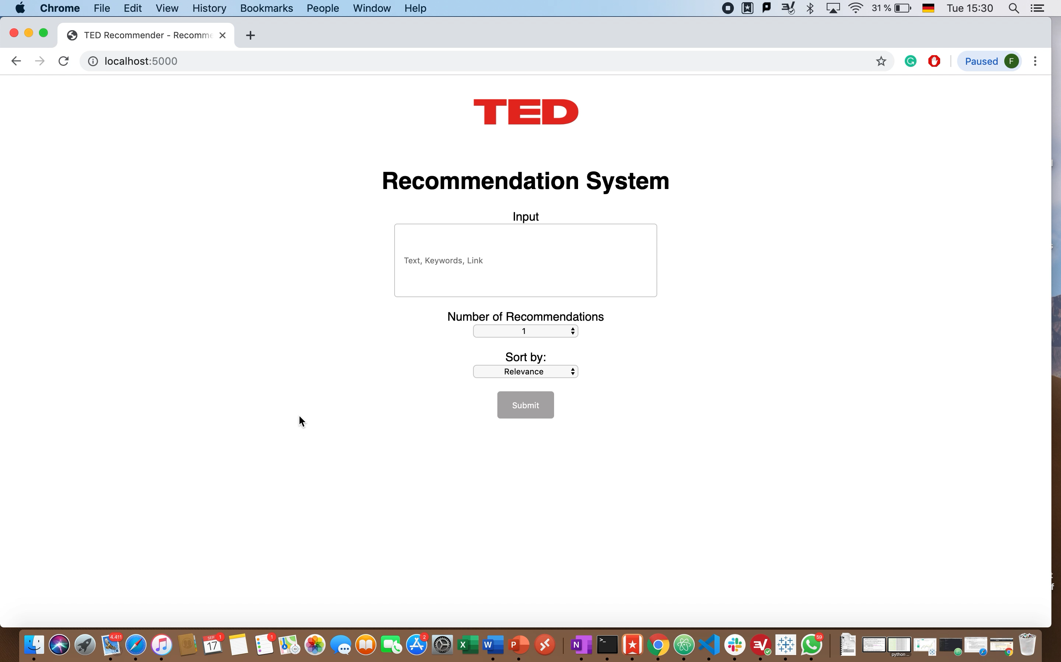
Notes:
Now lets have a look a the web app.
Let‘s say you are interested in climate change and want to look for related videos.
So you provide a text saying “If we dont act soon enough, the climate change will be irreversible.
You can set the number of results and you only want to sort the videos according to the upload date to find the most recent ones.
The name greta thunberg sounds familiar so you can directly go to the video by pressing on the watch button.
If you enjoyed the video, you can take the link and let the recommender recommend similar videos to the video you just watched, but now you sort them according to views.
Lastly, you can also provide keywords, in this case sustainability, which will provide videos according to relevance in this case.

Slide 9



Conclusion
Final Product: Sophisticated Search Engine for TED talks
Ecosystem and Religion currently trending topics
Contact information:
ferdiwo
in/ferdinandwohlenberg
FerdinandJu@t-online.de
Notes:
Concluding, the project resulted in a sophisticated Search Engine for Ted Talks
And looking at the topics, ecosystem and religion are currently trending topics
If you have any questions, please dont hesitate to contact me under the following channels
Transiotion fromtopic over time to flask web app, felt disjointed
Now that we looked at themost recent trends id like to show you the web app
Fill the gaps in the video, fill the time to smoothen it up

Slide 10
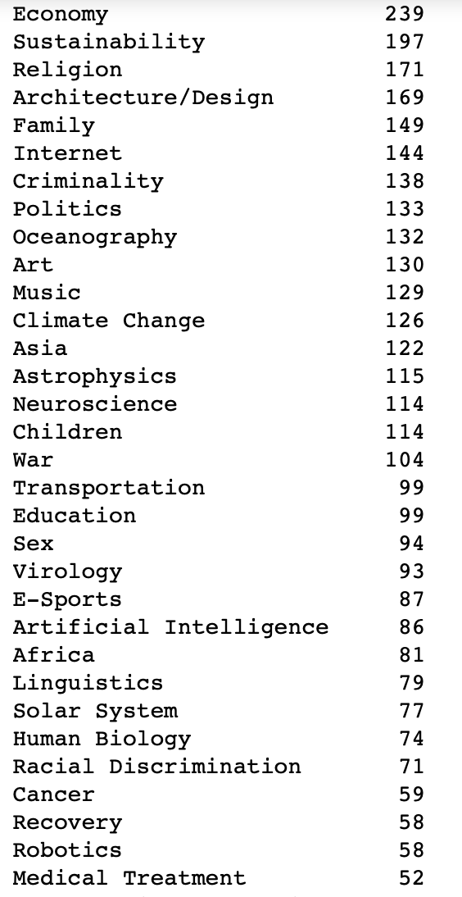
Appendix – List of Topics

Slide 11
Why?
Big fan of TED talks
Well compressed information mixed with valuable experience
Everyone can host a TED talk (TEDx)
Multitude of different topics

Slide 12
Data Preprocessing
Procedure
Source: www.ted.com
Operations:
Scraped >4,000 Ted Talks
Filtered for English videos
Cleaned up transcripts and descriptions
Lemmatization
Tools
Selenium
NLTK
BeautifulSoup

